Slide 1
ICT-PreAward-eCAT-
Pre_Award_eCatalogue_ICT_ Architectural_Strategy-1.01
Version: 1.0.1
Status: In use
Editors: Giancarlo De Stefano, Consip
Leonardo Bertini, Consip
Selmin Ustaoglu, Consip

Slide 2
Statements
Statement of originality
This deliverable contains original unpublished work except where clearly indicated otherwise. Acknowledgement of previously published material and of the work of others has been made through appropriate citation, quotation or both.
Statement of copyright
This deliverable is released under the terms of the Creative Commons Licence accessed through the following link: http://creativecommons.org/licenses/by/3.0/.
In short, it is free to
Share — to copy, distribute and transmit the work
Remix — to adapt the work
Under the following conditions
Attribution — You must attribute the work in the manner specified by the author or licensor
(but not in any way that suggests that they endorse you or your use of the work).
Page <number>

Slide 3
Revision History
Version | Date | Editor | Org | Description
1.0.0 | 01.06.2011 | Giancarlo De Stefano, Leonardo Bertini Selmin Ustaoglu | Consip | First release
1.0.1 | 30.06.2012 | Giancarlo De Stefano | Consip | Update for full alignement with PEPPOL EIA Release 4 and Transfer of Ownership
Page <number>

Slide 4

Pre-Award eProcurement - ICT Architecture Strategy for eCatalogues
    The pre-award eCatalogue ICT Architecture Strategy aims at defining the conditions for the business level strategy to be implemented, and addressing the fundamental reasons for the choices made by the project.
    As said above, identifying the business level strategy, the improvement of eCatalogue interoperability in the pre-award passes through the wider use of standardized content (addressing the semantic layer of the European Interoperability Framework).
Page <number>

Slide 5
Pre-Award eProcurement - ICT Architecture Strategy for eCatalogues
  The main issue that PEPPOL tries to solve in the PreAward eCatalogue interoperability can be expressed as follows:
  The widespread use of electronic pre-award Catalogues in public procurement is not favoured by the current practices of the Contracting Authorities, who have the habit to create own templates, managed with ad hoc tools, which requires to economic operators manual adaptation of the eCatalogue content.This problem requires a wider adoption of standardised eCatalogues from the contracting authorities, but there is a still full range of options on how to make this in practice.
Page <number>

Slide 6
Pre-Award eProcurement - ICT Architecture Strategy for eCatalogues
  The solution must therefore focus on the two levels of the content related challenges identified above:
    increasing the use of multiple classification systems, possibly open, international and multilingual, for an easier identification of eCatalogue items from both buyers (when describing the items to purchase) and suppliers (when describing the offer in response to a tender);
    Increasing the use of standardized attributes to describe the item properties, by using property dictionaries as much as possible open, international and multilingual, ideally cross-referred to other dictionaries, and integrated/mappable with multiple classification systems.
Page <number>

Slide 7
Pre-Award eProcurement - ICT Architecture Strategy for eCatalogues
The implementation of the two levels above should be done envisaging a more ambitious long run solution, which is the creation at a later stage of a community that, based on the combination of item classification and standardized properties, creates and shares an ontology for the description of a wide range goods and services.
Page <number>

Slide 8
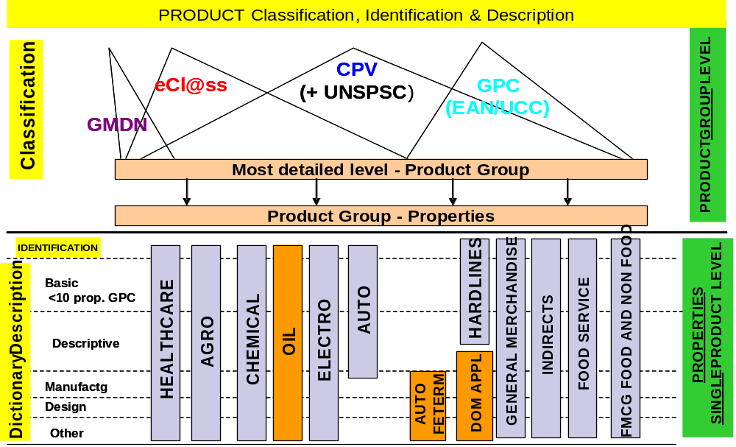
Pre-Award eProcurement - ICT Architecture Strategy for eCatalogues
The strategy can be represented graphically by the following picture:
the goal is to push on the integration of classification systems for the identification of goods and services, and on the use of standardized dictionaries to describe the product properties.
Page <number>

Slide 9
Pre-Award eProcurement - ICT Architecture Strategy for eCatalogues
Translating this business strategy into an ICT Architecture strategy, the key requirements to pinpoint are:
    wide use
    standardization of terms
    International
    multilingual
    easy access
to which the key requirements of PEPPOL should be added:
    interoperability
    integration and not replacement of existing solutions
Page <number>

Slide 10
Pre-Award eProcurement - ICT Architecture Strategy for eCatalogues
  These requirements lead to think of an Architecture for PreAward eCatalogue interoperability based, on one side, on a central component, the PEPPOL Property Server (PPS) for the provision of standardized content to be used in eCatalogues by contracting authorities and economic operators; and on the other side, on the integration into the existing systems of contracting authorities and economic operators of a set of pre-defined components, respecting PEPPOL specifications, that in the case of pre-award eCatalogue focus mainly on the transformation and validation of the eCatalogue data model of the eCatalogue document rather than on the process for the exchange of eCatalogue.
Page <number>

Slide 11
Pre-Award eProcurement - ICT Architecture Strategy for eCatalogues
The reason for this is twofold: on one side PEPPOL specifications are generally based on the CEN/BII profiles, which (at the time PEPPOL had to implement them in real-life systems) are not stable enough for pre-award eCatalogues ; on the other side the exchange of eCatalogues in the pre-award is not a complex process “per se”, and it is generally not seen as a process separated by the tendering process (and in fact, CEN/BII 2 will release a new profile called “Tendering with eCatalogue”- that is adding to the “Tendering simple” profile)
Page <number>

Slide 12

Pre-Award eProcurement - ICT Architecture Principles
  Reusing and building existing work (at the time PEPPOL has implemented the specifications in real life systems) :
    of CEN Standardization Workshops as a foundation of solutions
      CEN ISSS WS/BII2
      CEN ISSS WS/eCat
    of other eProcurement groups in Europe
      CEN ISSS WS/eInv1, eInv2
      EuLab
    in the EU member states
  Cooperating with existing CEN workshops
    CEN/BII2
    WS/eCAT (in particular with the cMAP project)
Page <number>

Slide 13
Pre-Award eProcurement - ICT Architecture Principles
  Ensuring openness of :
    developer community, allowing the reusability of building blocks’ results on JOINUP.
    buyer community, through its online product property web service (ePPS ) of the chosen standardized dictionary, allowing user to manage it.
  Aligning solution and strategy with other pilot projects
    ePrior
    eSENS (i.e. The Large Scale Pilot answering the Basic Cross Sector Services Objective of CIP Work Programme 2012 .to be launched yet at the time the current Release 4 of PEPPOL EIA is delivered)
  Using new, but still mature technologies with own Life Cycle Management and Governance in place
Page <number>

Slide 14

eProcurement
without borders in Europe
www.peppol.eu
Page <number>

